Slide 1
Building Highly Scalable Web applications
BASE gives way to ACID
Dinesh Varadharajan
Director – Engineering
OrangeScape technologies

Slide 2
What is scalability?
A service is said to be scalable if when we increase the resources in a system, it results in increased performance in a manner proportional to resources added.
Werner Vogels CTO - Amazon.com

Slide 3
If your system is
slow for a single user
Performance is the problem

Slide 4
If your system is
fast for a single user but slow if
many users access it.
Scalability is the problem

Slide 5
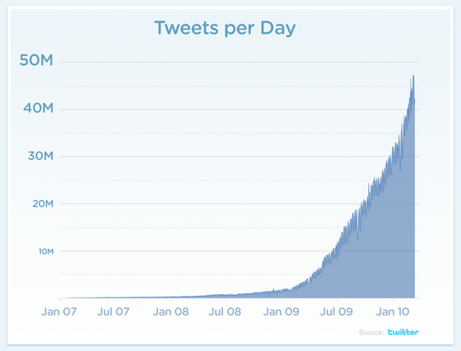
Growth story of a successful webapp

Slide 6
Why scalability is important for today’s web apps
Design for scale
Unpredictable growth
1-million in weeks or months
100% availability

Slide 7
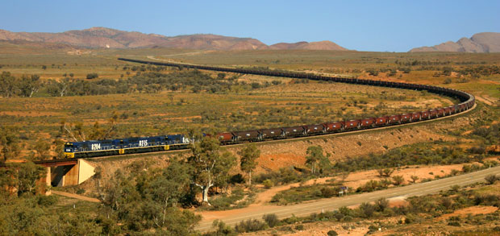
Scale up

Slide 8
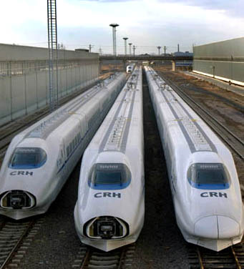
Scale out

Slide 9
And the villain is
Scaling app server is easy.
The bottleneck is the database
Not designed for scale out

Slide 10
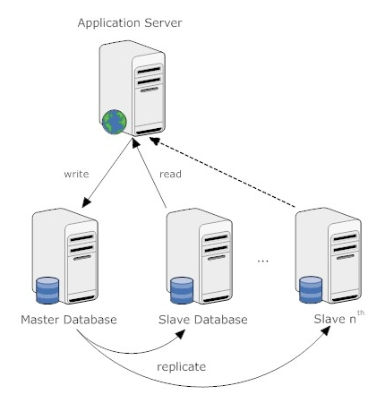
Scaling RDBMS – Master/Slave

Slide 11
Scaling RDBMS – Master/Slave
Master-Slave
All writes are written to the master.
Critical reads may be incorrect as writes may not have been propagated down
Large data sets can pose problems as master needs to duplicate data to slaves

Slide 12
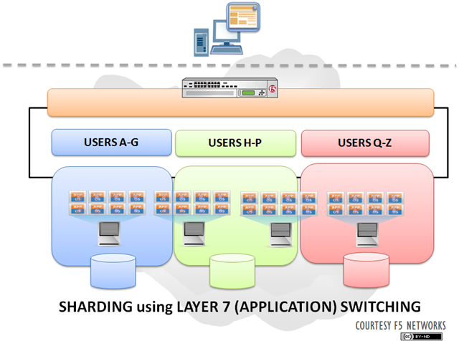
Scaling RDBMS - Sharding

Slide 13
Scaling RDBMS - Sharding
Partition or sharding
Scales well for both reads and writes
eg. users belong to a location stored together or related entities stored together
Not transparent, application needs to be partition-aware
No Joins
Loss of referential integrity across shards
So the constraints are moved away from datastore and are part of application
Notes:
-> Different sharding approaches:
-> Vertical Partitioning: Have tables related to a specific feature sit on their own server. May have to rebalance or reshard if tables outgrow server.
-> Range-Based Partitioning: When single table cannot sit on a server, split table onto multiple servers. Split table based on some critical value range.
-> Key or Hash-Based partitioning: Use a key value in a hash and use the resulting value as entry into multiple servers.
-> Directory-Based Partitioning: Have a lookup service that has knowledge of the partitioning scheme . This allows for the adding of servers or
changing the partition scheme without changing the application.
-> http://adam.heroku.com/past/2009/7/6/sql_databases_dont_scale

Slide 14
there is only one choice to make. In case of
a network partition, what do you sacrifice?
C: Consistency
A: Availability

Slide 15
CAP
Consistency. The client perceives that a set of operations has occurred all at once.
Availability. Every operation must terminate in an intended response.
Partition tolerance. Operations will complete, even if individual components are unavailable.

Slide 16
Brewer's CAP Theorem
Consistency
Can’t ensure all
3 at once
Availability
Partition Tolerance

Slide 17
Intelligent
Can’t ensure all
3 at once
Good looking
Available

Slide 18
for·go strict consistency
Strict Consistency can't be achieved at the
same time as availability and partition-
tolerance.

Slide 19
Basically Available
Soft state
Eventually consistent

Slide 20
ACID vs. BASE
ACID
Strong consistency
Isolation
Focus on “commit”
Nested transactions
Availability?
Conservative(pessimistic)
Difficult evolution(e.g. schema)
BASE
Weak consistency
– stale data OK
Availability first
Best effort
Approximate answers OK
Aggressive (optimistic)
Simpler!
Faster
Easier evolution
Courtesy: Brewer's keynote at PODC

Slide 21
Examples
Twitter
Facebook
Ebay
Almost the standard way of implementation across all the applications using nosql databases.

Slide 22
Who is what?
BigTable – Google – CP
Hbase – Apache – CP
HyperTable – Community - CP
Dynamo – Amazon – AP
SimpleDB – Amazon - AP
Voldemort – LinkedIn – AP
Cassandra – Facebook – AP
MemcacheDB - community – CP/AP

Slide 23
References
Brewer's Keynote on CAP
http://www.cs.berkeley.edu/~brewer/cs262b-2004/PODC-keynote.pdf
CAP articles:
http://www.julianbrowne.com/article/viewer/brewers-cap-theorem
http://www.allthingsdistributed.com/2008/12/eventually_consistent.html
BASE Articles
http://queue.acm.org/detail.cfm?id=1394128
BASE Presentation(few slides and inspiration from the following)
http://www.slideshare.net/jboner/scalability-availability-stability-patterns

Slide 24
Thank You

